Slide 1
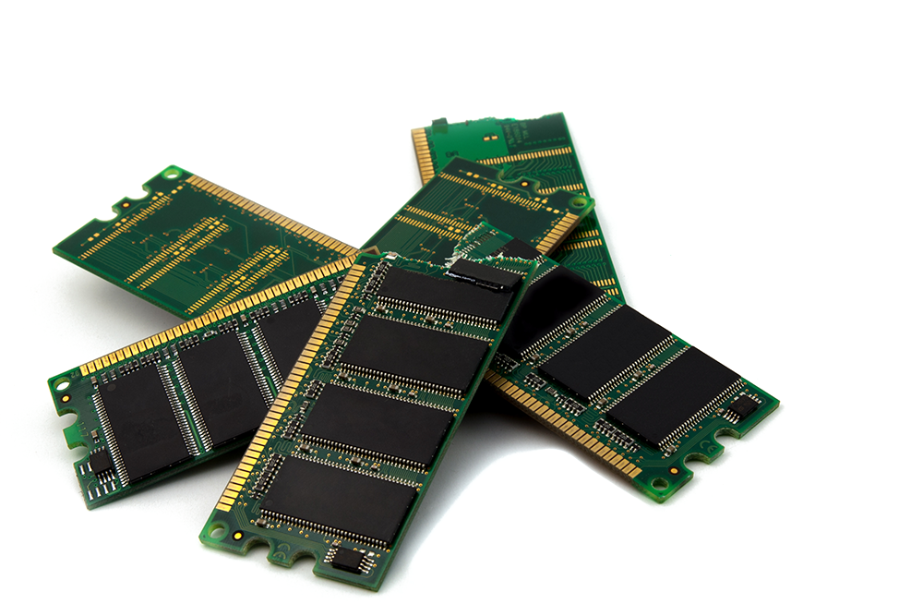
Computer Memory
Presented By
Bikal Thapa
Reeva M. Khadka

Slide 2
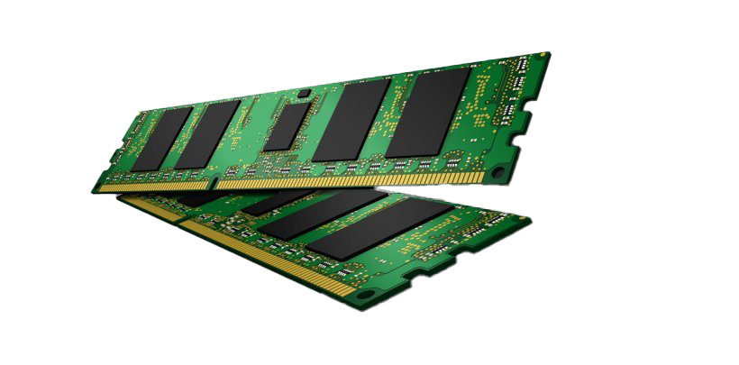
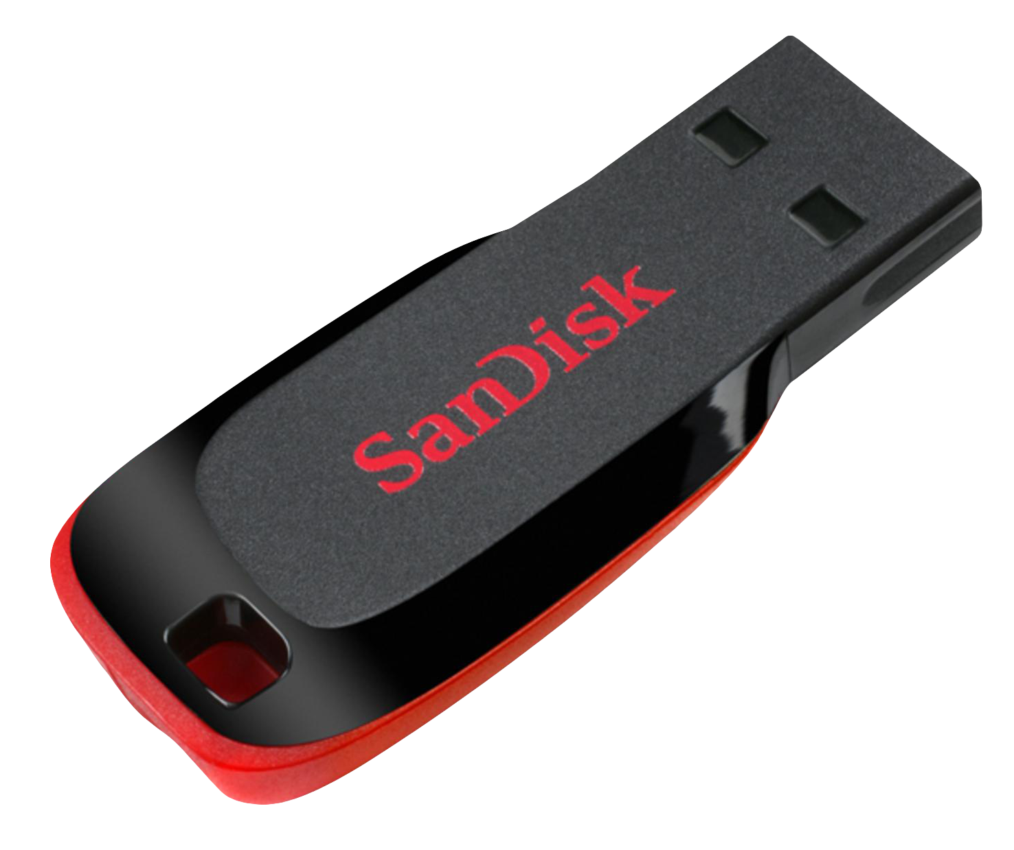
Computer Memory
Computer Memory Refers to the physical devices used to store data or programs temporarily or permanently in computer.
This Photo by Unknown Author is licensed under CC BY-NC

Slide 3
Memory Hierarchy
Cache Memory
Main Memory
USB/Flash Memory
Magnetic Disk/ Hard Disk
Magnetic Tapes / Tape Drives
Register
Arrangement of computer memory by their storage capacity, cost and performance.

Slide 4







Memory Characteristics
Cache Memory
Main Memory
USB/Flash Memory
Magnetic Disk/ Hard Disk
Magnetic Tapes / Tape Drives
Register
Location
Storage Capacity
Performance
Physical Character
Cost
Volatility

Slide 5
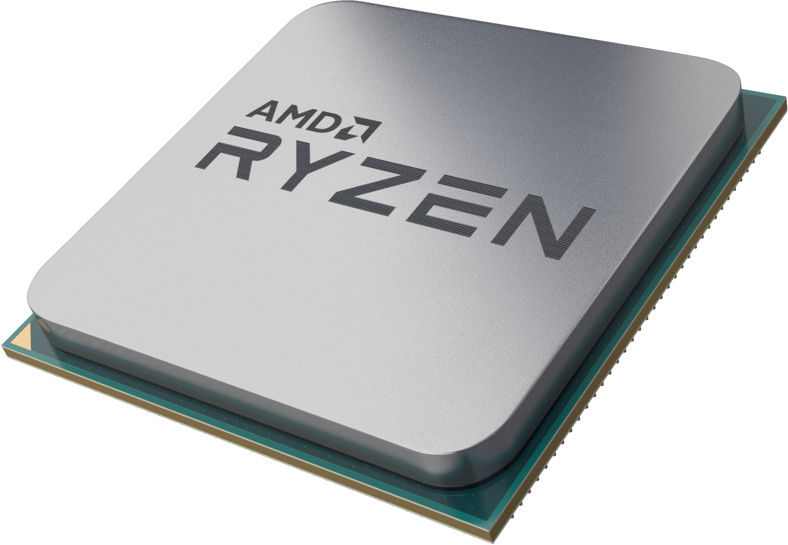
Registers
1
Present Inside the CPU.
Stores data temporarily in very small size (i.e Bytes)
2
For example : AC, PC, Flag Register, SP, etc.
3

Slide 6

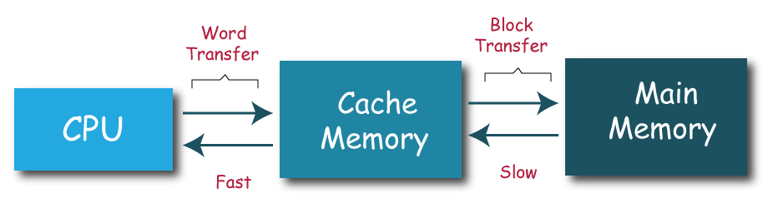
Cache Memory
Acts as buffer between Main memory and CPU
1
2
Stores the data up to KB or MB.
Divided into different levels such as L1, L2, L3, etc.
3

Slide 7
Primary Memory
Faster than secondary memory i.e, Hard Disk and other drives.
1
Very expensive as compared to secondary storage devices.
2
Most of the primary memory are volatile.
3
Stores the data temporarily. For example RAM, ROM, PROM, etc.
4

Slide 8
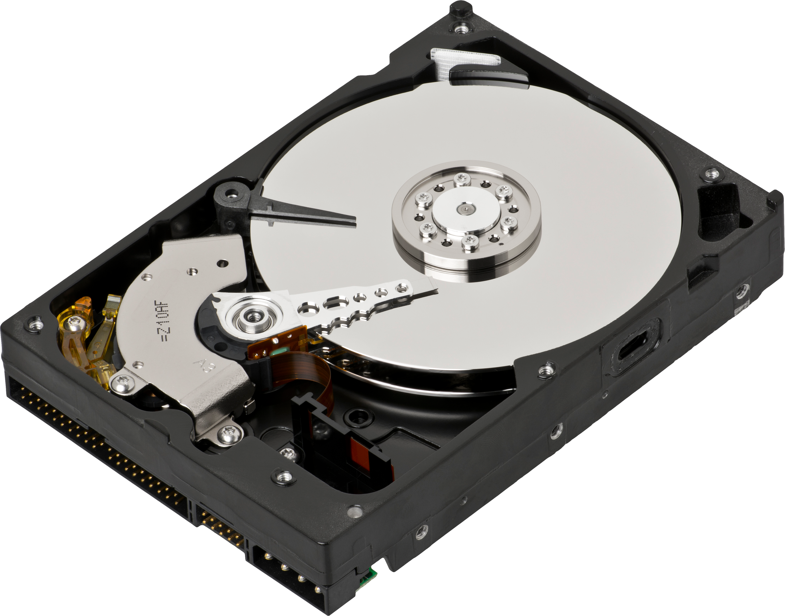
Secondary Memory
Large in size and store large amount of data (i.e upto TB ).
1
Stores data permanently unless it is changed by the user.
2
Slower as compared to primary memory or main memory.
3
Hard Disk Drive, Pen drive, CD drive are the Secondary Storage Device.
4

Slide 9
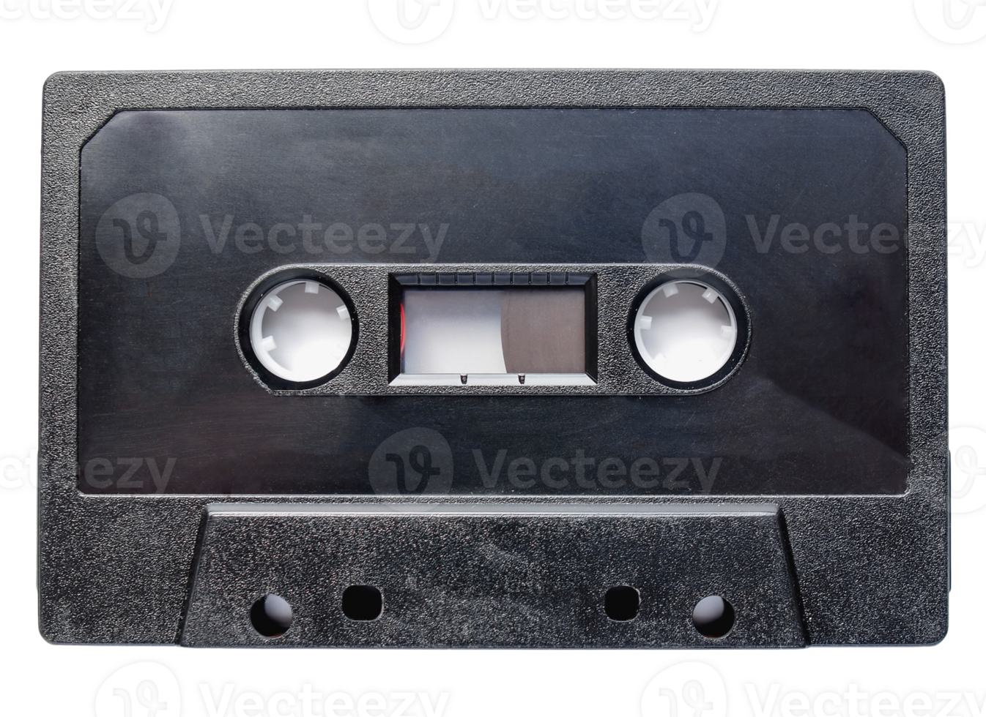

Tertiary Memory
Storages large amount of data in PB (Peta Bytes).
1
2
Most cheapest storage devices.
3
Low Performance.
Mostly used for backup and archival storage.
4

Slide 10
Thank You

